Slide 1
Medication Plan Monitoring System
Mobile Health & Sports
Final Presentation
Projectteam:
Endalkachew Asnake
Christoph Kieslich
Manuel Lindorfer
Bernhard Stemmer

Slide 2
Motivation
Did I take my medicine correctly?
Was it the correct dose?
Did I forget something?
Did I already take it?

Slide 3
DrugMe
App reminds you...
...to take your medicine!
...when and how often to take it!
...how much you have to take!

Slide 4
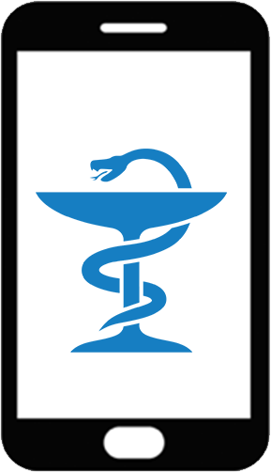



Big Picture
take medicine!
Patient
Server + Database
Doctor
register
Patient
Medical Plan
create plan
push plan

Slide 5
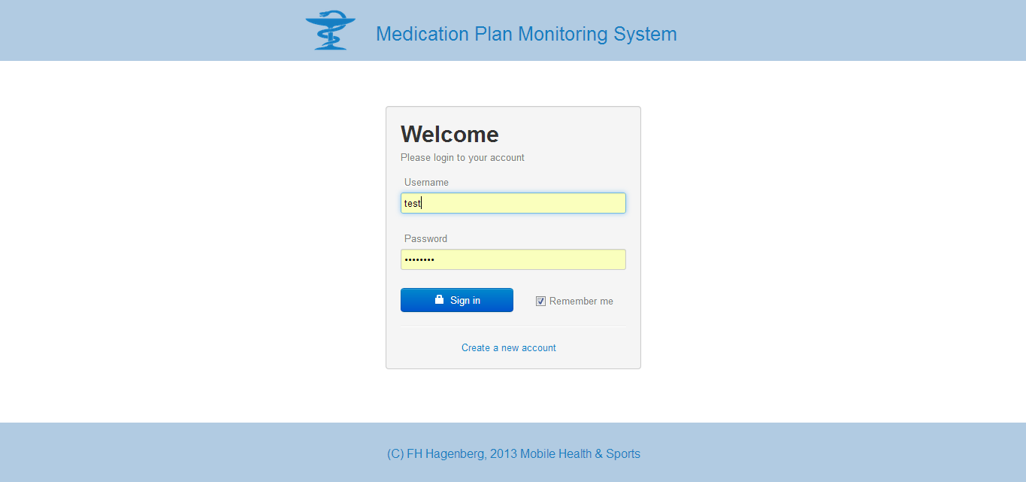
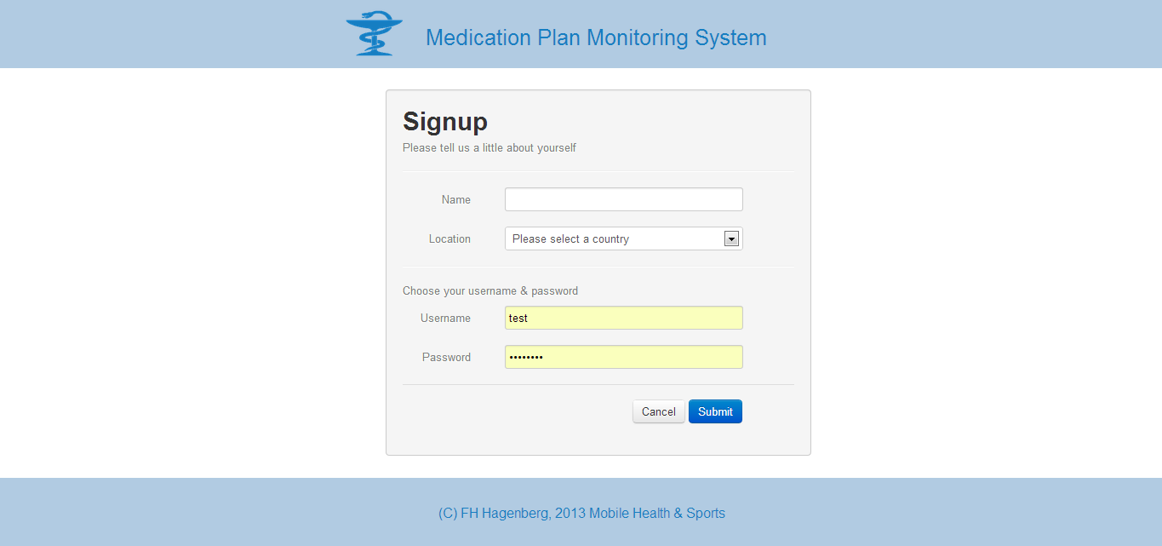
Website – Login/Sign in

Slide 6
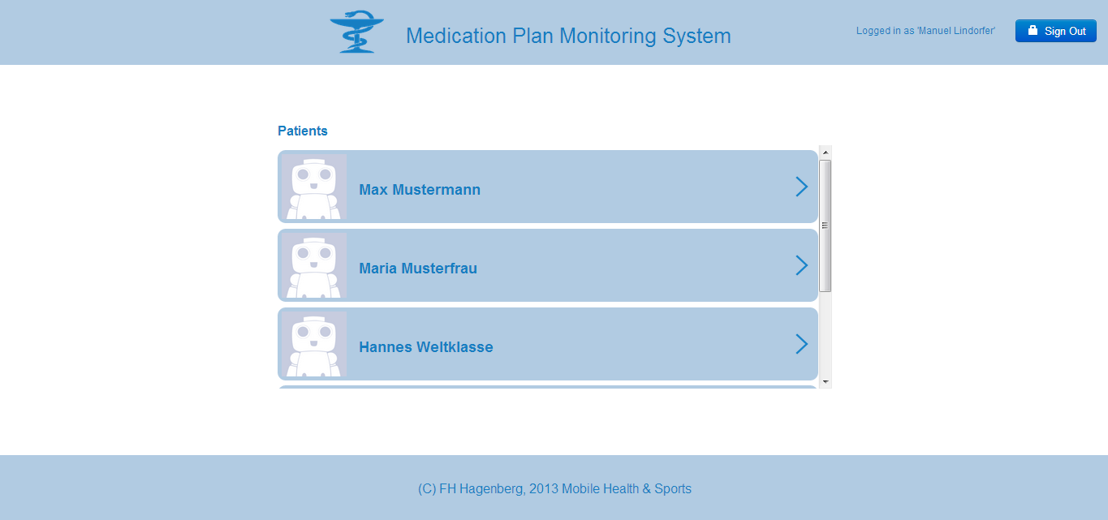
Website – Home Screen

Slide 7
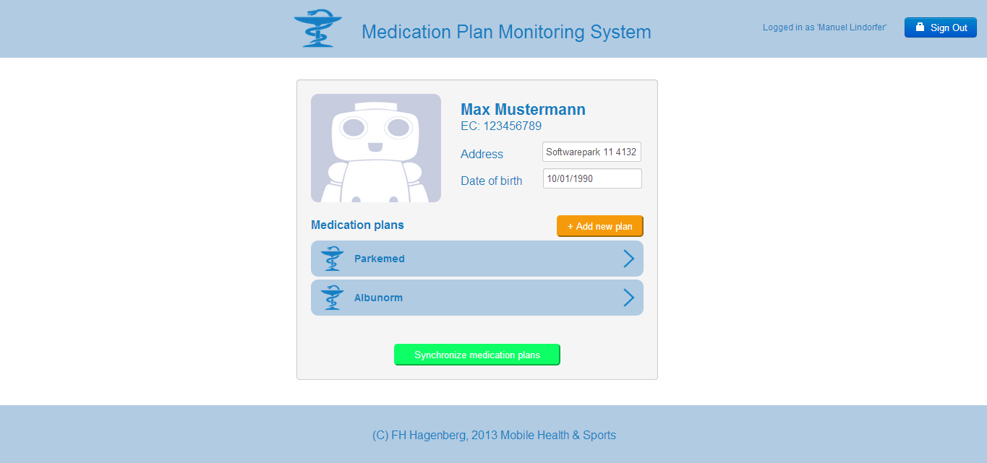
Website – Patient Detail

Slide 8
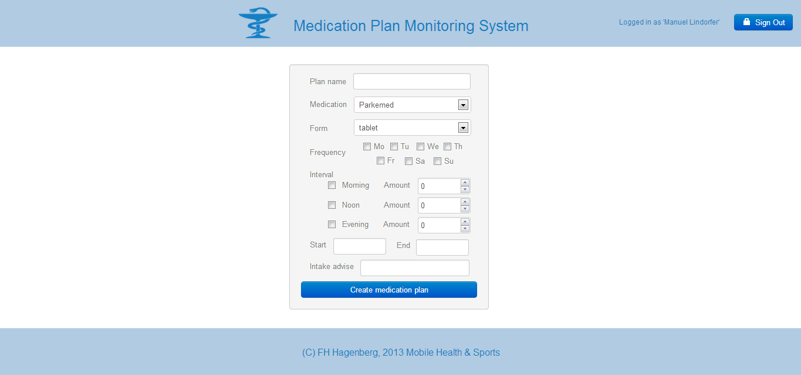
Website – create new plan

Slide 9
Website – Patient Detail

Slide 10
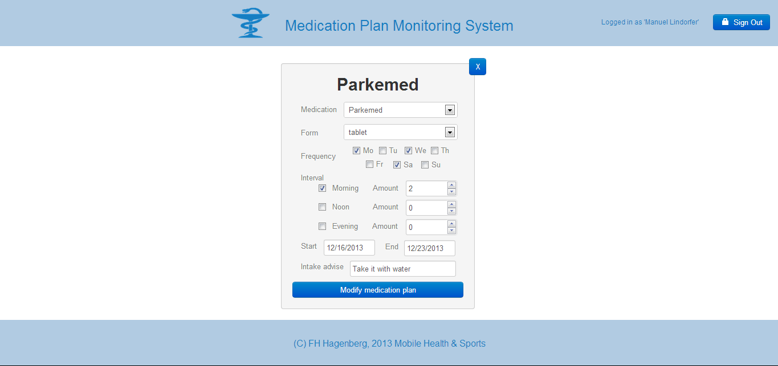
Website – edit plan

Slide 11
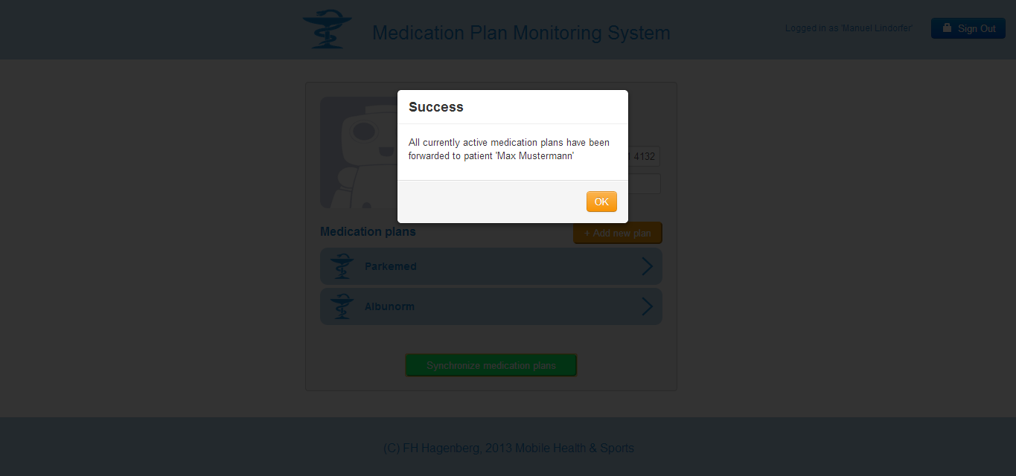
Website – Patient Detail

Slide 12
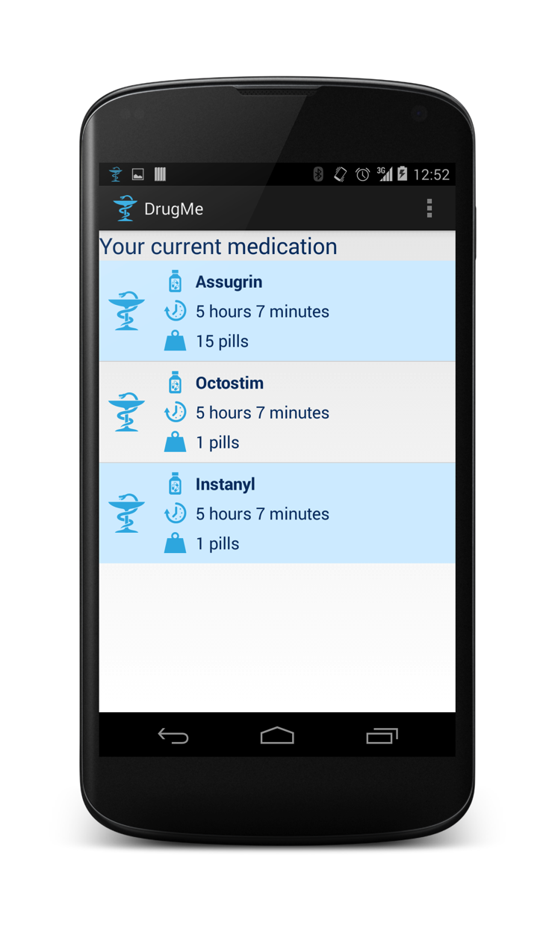
App – Startscreen

Slide 13
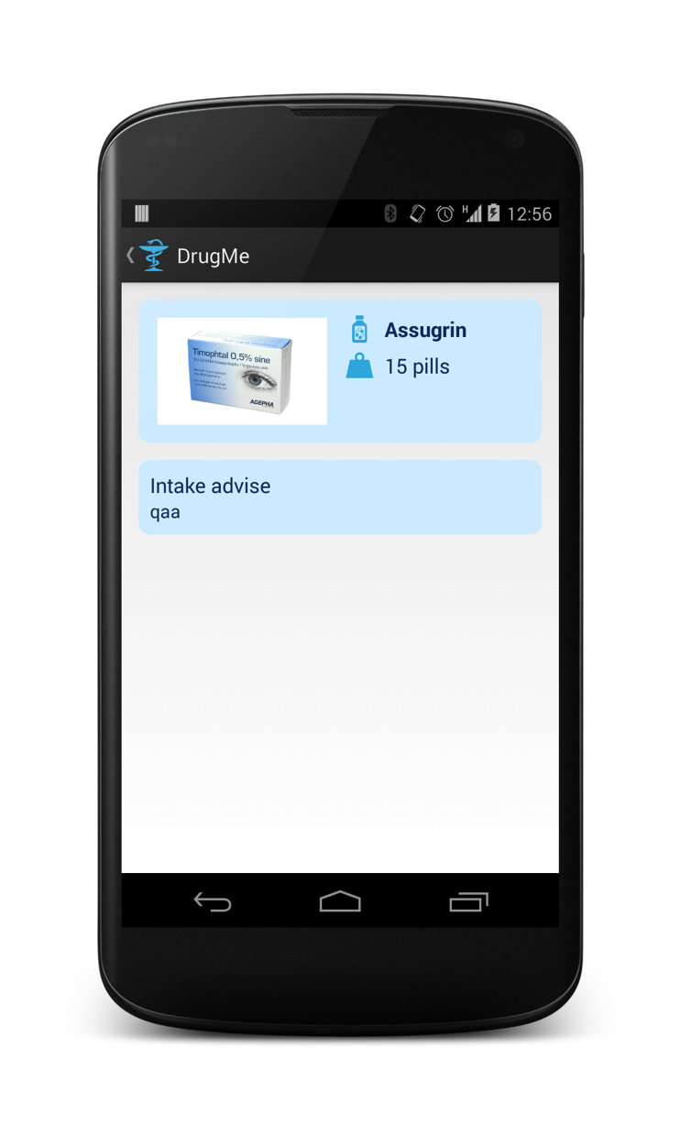
App – Medicine detail

Slide 14

App – Intake notification

Slide 15
App – Push notification

Slide 16
Possible extensions
Secure channel for data transfer
Medication plan template
Intake confirmation
Medication report
Notification Sounds for differnt Medicines
Medication Playlist
Daydream Function in Android

Slide 17
That was DrugMe
Thank‘s for your attention!
Questions!

